Slide 1
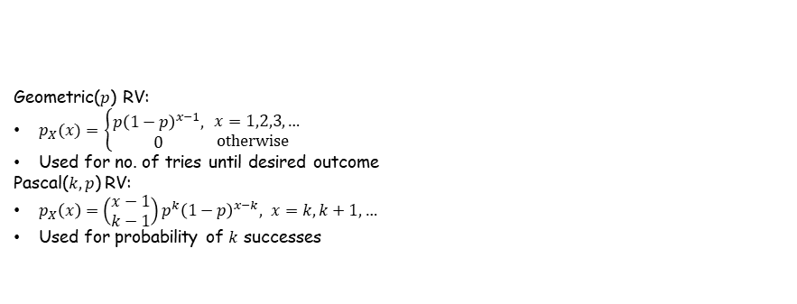
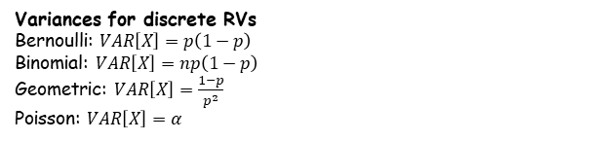
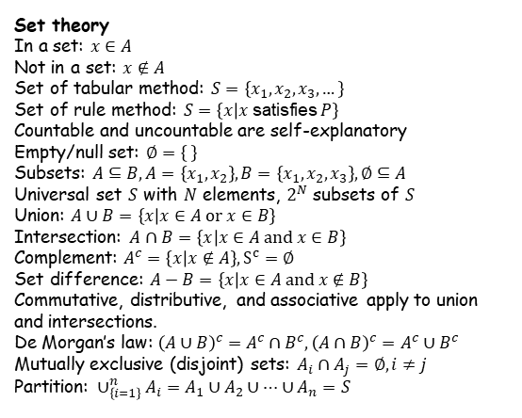


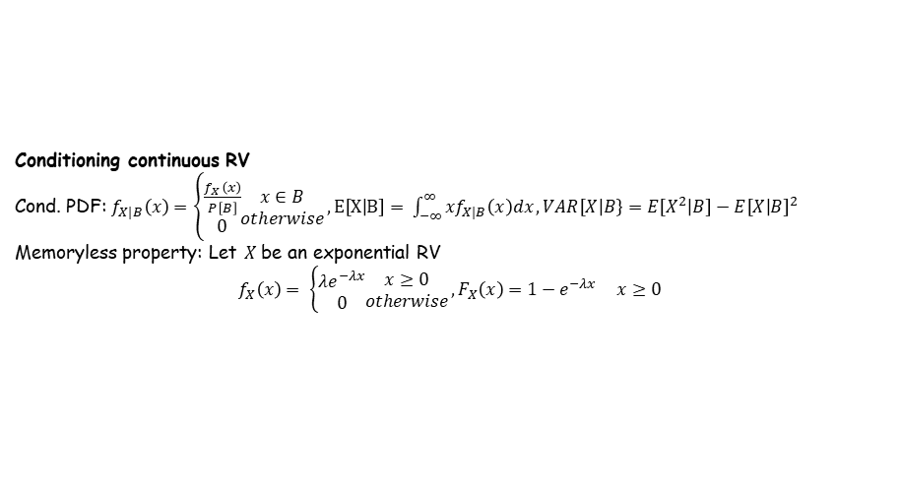

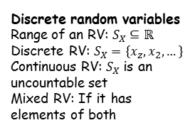

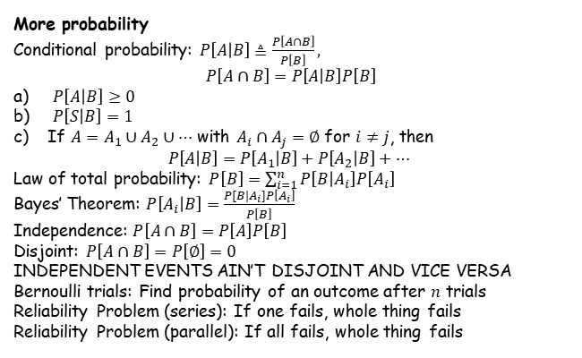
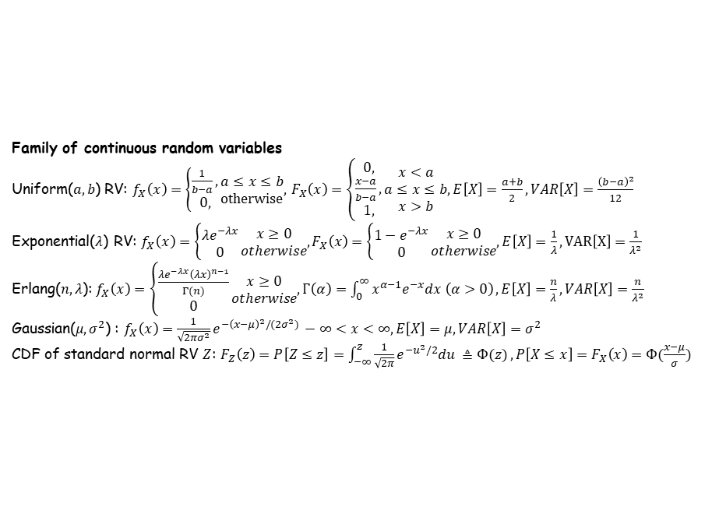

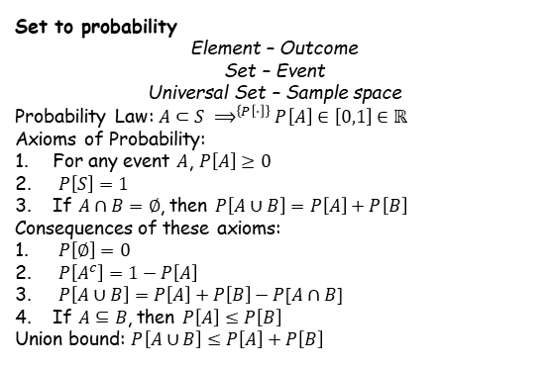
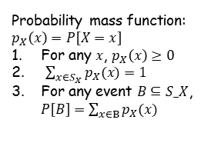
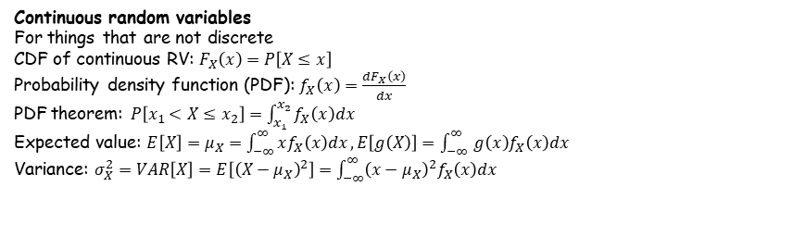
Probability
The chance something happens
We use models to represent a system
Types of models:
Deterministic: Outcome is determined by input conditions
Probabilistic/Stochastic: Outcome can vary; degree of randomness
Building a model:
Define the random experiment inherent in the problem,
Specify the set of all possible outcomes and events of interest,
Specify a probability assignment for the outcomes and events.
Family of discrete random variables
Bernoulli($p$) RV:
$p_{X}\left(x\right)=\left\{\begin{aligned}1−p, \\ p, \\ 0, \end{aligned}\begin{matrix}x=0 \\ x=1 \\ \text{otherwise}\end{matrix}\right.$
Used for experiments with 2 outcomes
Binomial($n,p)$ RV:
$p_{X}(x)=\left\{\begin{aligned}\left({n \atop x}\right)p^{x}{\left(1−p\right)}^{n−x}, \\ 0,\end{aligned}\right.\begin{matrix}x=0,1,2,…,n \\ \text{otherwise}\end{matrix}$
Used in exp. with $n$ trials of 2 outcomes
Poisson($α$) RV:
$p_{X}\left(x\right)=\left\{\begin{aligned}\frac{α^{x}e^{−a}}{x!}, \\ 0,\end{aligned}\begin{matrix} x=0,1,2,… \\ \text{otherwise}\end{matrix}\right.$, $α=λT$
Used for number of completely random events
Geometric($p$) RV:
$p_{X}(x)=$ $\left\{\begin{aligned}p{\left(1−p\right)}^{x−1}, \\ 0\end{aligned}\right.\begin{matrix} x=1,2,3,… \\ \text{otherwise}\end{matrix}$
Used for no. of tries until desired outcome
Pascal($k,p$) RV:
$p_{X}\left(x\right)=\left(\begin{matrix}x−1 \\ k−1\end{matrix}\right)p^{k}{\left(1−p\right)}^{x−k}, x=k,k+1,…$
Used for probability of $k$ successes
Expected Value
Expected value: $E\left[X\right]=μ_{X}=∑xp_{X}\left(x\right)$
Bernoulli: $E\left[X\right]=p$
Binomial: $E\left[X\right]=np$
Geometric: $E\left[X\right]=\frac{1}{p}$
Poisson: $E\left[X\right]=α$
Set theory
In a set: $x∈A$
Not in a set: $x∉A$
Set of tabular method: $S=\left\{x_{1},x_{2},x_{3},…\right\}$
Set of rule method: $S=\left\{x | x \text{satisfies} P\right\}$
Countable and uncountable are self-explanatory
Empty/null set: $∅=\left\{ \right\}$
Subsets: $A⊆B, A=\left\{x_{1},x_{2}\right\},B=\left\{x_{1},x_{2},x_{3}\right\},∅⊆A$
Universal set $S$ with $N$ elements, $2^{N}$ subsets of $S$
Union: $A∪B=\left\{x | x∈A \text{or} x∈B\right\}$
Intersection: $A∩B=\left\{x | x∈A \text{and} x∈B\right\}$
Complement: $A^{c}=\left\{x | x∉A\right\}, S^{c}=∅$
Set difference: $A−B=\left\{x | x∈A \text{and} x∉B\right\}$
Commutative, distributive, and associative apply to union and intersections.
De Morgan’s law: ${\left(A∪B\right)}^{c}=A^{c}∩B^{c},{\left(A∩B\right)}^{c}=A^{c}∪B^{c}$
Mutually exclusive (disjoint) sets: $A_{i}∩A_{j}=∅,i≠j$
Partition: $∪_{\left\{i=1\right\}}^{n}A_{i}=A_{1}∪A_{2}∪…∪A_{n}=S$
Cumulative distribution function
CDF: $F_{X}\left(x\right)=P[X≤x]$
CDF is cumulative, while PMF is per value
CDF is 1 at the end, while PMF is not
Theorem: $F_{X}\left(b\right)−F_{X}\left(a\right)=P[a<X≤B]$
Variances for discrete RVs
Bernoulli: $VAR\left[X\right]=p\left(1−p\right)$
Binomial: $VAR\left[X\right]=np\left(1−p\right)$
Geometric: $VAR\left[X\right]=\frac{1−p}{p^{2}}$
Poisson: $VAR\left[X\right]=α$
Function of RV
Function: $Y=g\left(X\right)$
For discrete, PMF is: $p_{Y}\left(y\right)=\sum_{\left\{x | g\left(x\right)=y\right\}}{p_{X}(x)}$
Expected value of Y: $μ_{Y}=E\left[Y\right]=E\left[g\left(x\right)\right]=\sum_{x∈S_{X}}{g\left(x\right)p_{X}(x)}$
Linear func of RV: $E\left[aX+b\right]=aE\left[X\right]+b$
Variance: $VAR\left[X\right]=σ_{X}^{2}≜E\left[{\left(X−μ_{X}\right)}^{2}\right]=\sum_{x∈S_{X}}{{\left(x−μ_{X}\right)}^{2}p_{X}\left(x\right)}$
Also variance: $VAR\left[X\right]=E\left[X^{2}\right]−{\left(E\left[X\right]\right)}^{2}$
Also variance: $VAR\left[aX+b\right]=a^{2}VAR\left[X\right]$ $∈S_X$
Conditional PMF: $p_{X|B}\left(x\right)=P\left[X=x | B\right]$
Continuous random variables
For things that are not discrete
CDF of continuous RV: $F_{X}\left(x\right)=P\left[X≤x\right]$
Probability density function (PDF): $f_{X}\left(x\right)=\frac{dF_{X}\left(x\right)}{dx}$
PDF theorem: $P\left[x_{1}<X≤x_{2}\right]=\int_{x_{1}}^{x_{2}}{f_{X}\left(x\right)dx}$
Expected value: $E\left[X\right]=μ_{X}=\int_{−∞}^{∞}{xf_{X}\left(x\right)dx}, E\left[g\left(X\right)\right]=\int_{−∞ }^{∞}{g\left(x\right)f_{X}\left(x\right)dx}$
Variance: $σ_{X}^{2}=VAR\left[X\right]=E\left[{\left(X−μ_{X}\right)}^{2}\right]=\int_{−∞}^{∞}{{\left(x−μ_{X}\right)}^{2}f_{X}\left(x\right)dx}$
Set to probability
Element – Outcome
Set – Event
Universal Set – Sample space
Probability Law: $A⊂S ⟹^{\left\{P\left[⋅\right]\right\}}P\left[A\right]∈\left[0,1\right]∈ℝ$
Axioms of Probability:
For any event $A$, $P\left[A\right]≥0$
$P\left[S\right]=1$
If $A∩B=∅$, then $P\left[A∪B\right]=P\left[A\right]+P\left[B\right]$
Consequences of these axioms:
$P\left[∅\right]=0$
$P\left[A^{c}\right]=1−P\left[A\right]$
$P\left[A∪B\right]=P\left[A\right]+P\left[B\right]−P[A∩B]$
If $A⊆B$, then $P\left[A\right]≤P\left[B\right]$
Union bound: $P\left[A∪B\right]≤P\left[A\right]+P\left[B\right]$
Validity of a PDF: $f_{X}\left(x\right)≥0$ and $\int_{−∞}^{∞}{f_{X}\left(x\right)}=1$
Family of continuous random variables
Uniform($a,b$) RV: $f_{X}\left(x\right)=\left\{\begin{aligned}\frac{1}{b−a}, \\ 0,\end{aligned}\right.\begin{matrix}a≤x≤b \\ \text{otherwise}\end{matrix},$ $F_{X}\left(x\right)=\left\{\begin{aligned}0, \\ \frac{x−a}{b−a}, \\ 1,\end{aligned}\right.\begin{matrix}x<a \\ a≤x≤b \\ x>b\end{matrix}, E\left[X\right]=\frac{a+b}{2}, VAR\left[X\right]=\frac{{\left(b−a\right)}^{2}}{12}$
Exponential($λ$) RV: $f_{X}\left(x\right)=\left\{\begin{aligned}λe^{−λx} \\ 0\end{aligned}\right.\begin{matrix}x≥0 \\ otherwise\end{matrix}, F_{X}\left(x\right)=$ $\left\{\begin{aligned}1−e^{−λx} \\ 0\end{aligned}\right.\begin{matrix}x≥0 \\ otherwise\end{matrix}, E\left[X\right]=\frac{1}{λ}, VAR\left[X\right]=\frac{1}{λ^{2}}$
Erlang($n,λ$): $f_{X}\left(x\right)=\left\{\begin{aligned}\frac{λe^{−λx}{\left(λx\right)}^{n−1}}{Γ(n)} \\ 0\end{aligned}\right.\begin{matrix}x≥0 \\ otherwise\end{matrix}, Γ\left(α\right)=\int_{0}^{∞}{x^{α−1}e^{−x}dx \left(α>0\right)}, E\left[X\right]=\frac{n}{λ}, VAR\left[X\right]=\frac{n}{λ^{2}}$
Gaussian($μ,σ^{2}$) : $f_{X}\left(x\right)=\frac{1}{\sqrt{2πσ^{2}}}e^{−{\left(x−μ\right)}^{2}/(2σ^{2})} −∞<x<∞, E\left[X\right]=μ, VAR\left[X\right]=σ^{2}$
CDF of standard normal RV $Z$: $F_{Z}\left(z\right)=P\left[Z≤z\right]=\int_{−∞}^{z}{\frac{1}{\sqrt{2π}}e^{−u^{2}/2}du ≜Φ(z)}, P\left[X≤x\right]=F_{X}\left(x\right)=Φ(\frac{x−μ}{σ})$
More probability
Conditional probability: $P\left[A | B\right]≜\frac{P\left[A∩B\right]}{P\left[B\right]},$
$$P\left[A∩B\right]=P\left[A | B\right]P\left[B\right]$$
$P\left[A | B\right]≥0$
$P\left[S | B\right]=1$
If $A=A_{1}∪A_{2}∪…$ with $A_{i}∩A_{j}=∅$ for $i≠j$, then
$$P\left[A | B\right]=P\left[A_{1} | B\right]+P\left[A_{2} | B\right]+…$$
Law of total probability: $P\left[B\right]=\sum_{i=1}^{n}{P\left[B | A_{i}\right]P\left[A_{i}\right]}$
Bayes’ Theorem: $P\left[A_{i} | B\right]=\frac{P[B|A_{i}]P\left[A_{i}\right]}{P\left[B\right]}$
Independence: $P\left[A∩B\right]=P\left[A\right]P\left[B\right]$
Disjoint: $P\left[A∩B\right]=P\left[∅\right]=0$
INDEPENDENT EVENTS AIN’T DISJOINT AND VICE VERSA
Bernoulli trials: Find probability of an outcome after $n$ trials
Reliability Problem (series): If one fails, whole thing fails
Reliability Problem (parallel): If all fails, whole thing fails
Conditioning continuous RV
Cond. PDF: $f_{X|B}\left(x\right)=\left\{\begin{aligned}\frac{f_{X}\left(x\right)}{P\left[B\right]} \\ 0\end{aligned}\begin{matrix}x∈B \\ otherwise\end{matrix}\right., E\left[X | B\right]= \int_{−∞}^{∞}{{xf}_{X|B}\left(x\right)dx}, VAR\left[X | B\right\}=E\left[X^{2} | B\right]−E{\left[X | B\right]}^{2}$
Memoryless property: Let $X$ be an exponential RV
$$f_{X}\left(x\right)= \left\{\begin{aligned}λe^{−λx} \\ 0\end{aligned}\begin{matrix}x≥0 \\ otherwise\end{matrix}\right., F_{X}\left(x\right)=1−e^{−λx} x≥0$$
Then we have $P\left[X>x+h | X>x\right]=P[X>h]$
Discrete random variables
Range of an RV: $S_{X}⊆ℝ$
Discrete RV: $S_{X}=\left\{x_{z}, x_{2},…\right\}$
Continuous RV: $S_{X}$ is an uncountable set
Mixed RV: If it has elements of both
Probability mass function: $p_{X}\left(x\right)=P\left[X=x\right]$
For any $x$, $p_{X}\left(x\right)≥0$
$\sum_{x∈S_{X}}{p_{X}(x)}=1$
For any event $B⊆S_X$, $P\left[B\right]=\sum_{x∈B}{p_{X}(x)}$

